Slide 1
Developing cohesive narratives
Linda Kurti
Alison Wallace
Urbis

Slide 2
Over the past two decades, in fact, there appears to have been a progressive decline in commitment to rigorous performance measurement and evaluation across the Commonwealth as a whole, and an accompanying decline in analytical and evaluative capability. Exacerbating the problem, evaluation appears to have been downgraded in the culture of many agencies…
(Australian Government Strategic Review of Indigenous Expenditure, Feb 2010, p 368)

Slide 3
A more strategic approach is needed to the setting of evaluation priorities, with closer attention to considerations of scale, policy significance and the interactions with other related programs (both within and across agencies and jurisdictions)…
There should also be more active encouragement of evaluations which study the interaction between different programs or groups of programs or which attempt to measure the relative effectiveness and efficiency of different approaches to addressing the same set of issues, including across jurisdictional boundaries.
(Australian Government Strategic Review of Indigenous Expenditure, Feb 2010, p 370)

Slide 4
Policy context
Purchaser-provider approach to governmental oversight
Whole of government approach
Complex, inter-related policy areas
High pressure, high stakes, high visibility

Slide 5
Role of evaluation
Evidence
Learning and improvement
Contribution to policy development
Evaluation frameworks can assist to articulate key priorities and aims and provide rigour

Slide 6
Process
Program logic
  Meeting/reading/research
  Draft
  Workshop
  Further draft(s)
Evaluation framework
  Identify questions/indicators/data sources/timing
  Draft and consultation

Slide 7
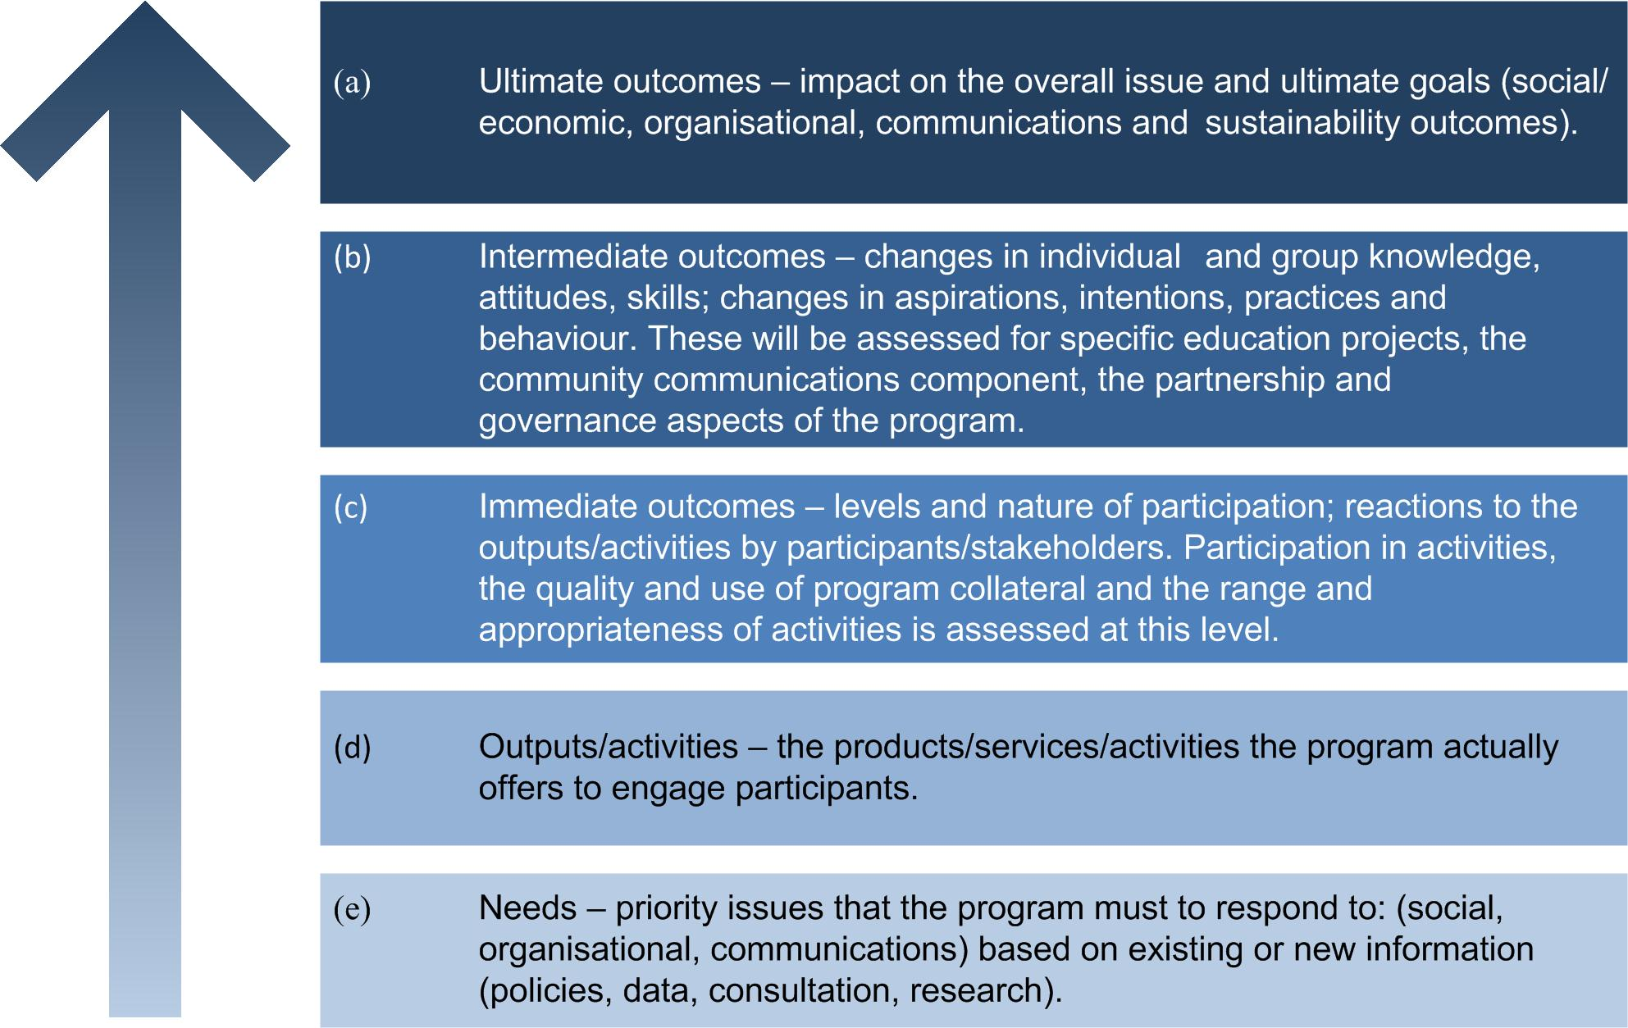
Program logic

Slide 8
Evaluation framework
Outcomes Hierarchy | Measures |  | Information Sources | Standard/ Judgement method | Evaluation output use
 | Evaluation questions | Indicators
Ultimate outcomes
Intermediate outcomes
Immediate outcomes
Outputs/activities
Needs

Slide 9
Case study 1
Large government department, program funded across number of services within that department
Each service had its own priorities and goals
Evaluation frameworks for each service, but also overarching
Individual project goals had to align with overarching goals

Slide 10
Key points
Different activities and priorities across sections of the one department
Development of EF at beginning, before some details were finalised – so uncertainty and changing operational details
High pressure to finalise in short period
Internal and external stakeholders – disparate views

Slide 11
Case study 2
Government department funded under larger whole-of government initiative
Aims of WoG crossed sectors
Different paradigms, and therefore operational priorities
Two branches within the same department, and two departments within the government

Slide 12
Key points
Importance of not just goal, but pathway
Aligning different paradigms, within departments as well as across sectors
Even with goodwill and commitment, it can be difficult for people to work across paradigms
Assumptions must be articulated and tested

Slide 13
Case study 3
Large government department, funded through COAG under NPA
Implementing national goals through state government programs
Ensuring that national, state and regional activities do not overlap or duplicate
Internal and external stakeholders, national and state stakeholders, cross-departmental

Slide 14
Key points
Need to align NPA goals with existing state priorities and activities
Need to ensure that state/regional/local activity is responsive to local need (not driven by national perspectives) – flexibility
Autonomy and control – between Commonwealth/state/territory, between state/regional/local

Slide 15
Messages for clients
It takes time
Ensure stakeholder clarity
Programs evolve, and implementation may change over time – that’s not a failure of the logic or the framework
It is an iterative process – does require your input, can’t be left to the evaluator

Slide 16
Messages for evaluators
Getting the logic right is important
Clarifying priorities and articulating assumptions now will save time later
Important to know what one is really trying to measure
Build relationships through building the logic
You can assist the client

Slide 17
Summary
Cohesive narrative can ground a project, and its evaluation
The process can assist stakeholders to work together and understand each other
Program logic can be a means to build trust and understanding
Requires something of everyone

Slide 18
Thank you!
Linda Kurti, Alison Wallace
Urbis
Level 21, 321 Kent Street
Sydney NSW 2000
02 8233 9900
lkurti@urbis.com.au; awallace@urbis.com.au

